Slide 1

IMBALANCED DATASETS

Slide 2
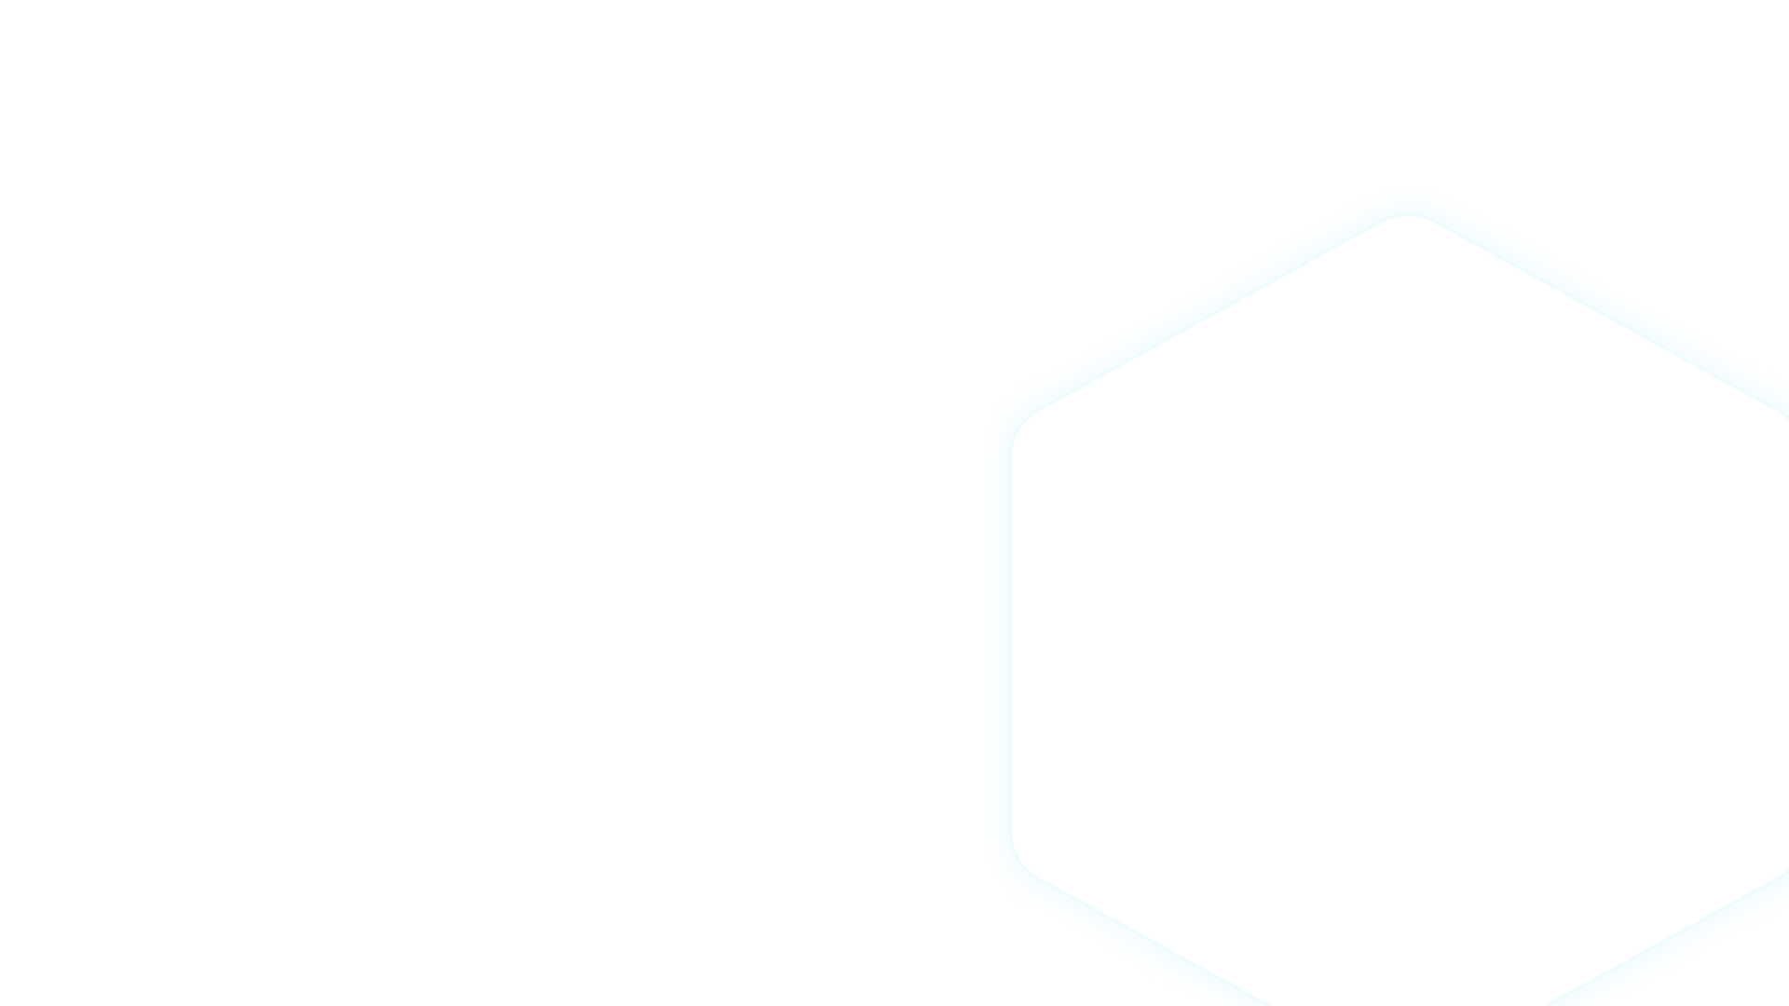
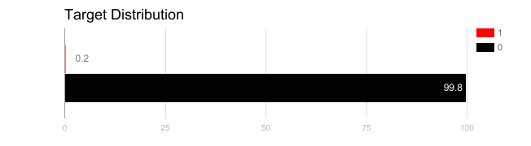
WHAT IS IMBALANCED DATA?
Imbalanced data applies to supervised classification problems and deals with the fact one or more of the target classes are extremely under represented in the dataset, compared to other classes
in 2018 in Britain 0.2% of credit card payments were fraudulent

Slide 3

BEFORE WE MOVE ON
Imbalanced data is a problem that mostly affects in a serious way the target variable we are trying to predict
Imbalance in a particular feature, on the other hand, is not necessarily a bad thing

Slide 4

HOW CAN WE SOLVE THIS PROBLEM?
Use the correct evaluation metrics
ReSampling the training set
Under-Sampling
Over-Sampling
Use K-Fold Cross-Validation
Cluster the abundant class / disperse the minority class
Design your own Cost Function

Slide 5
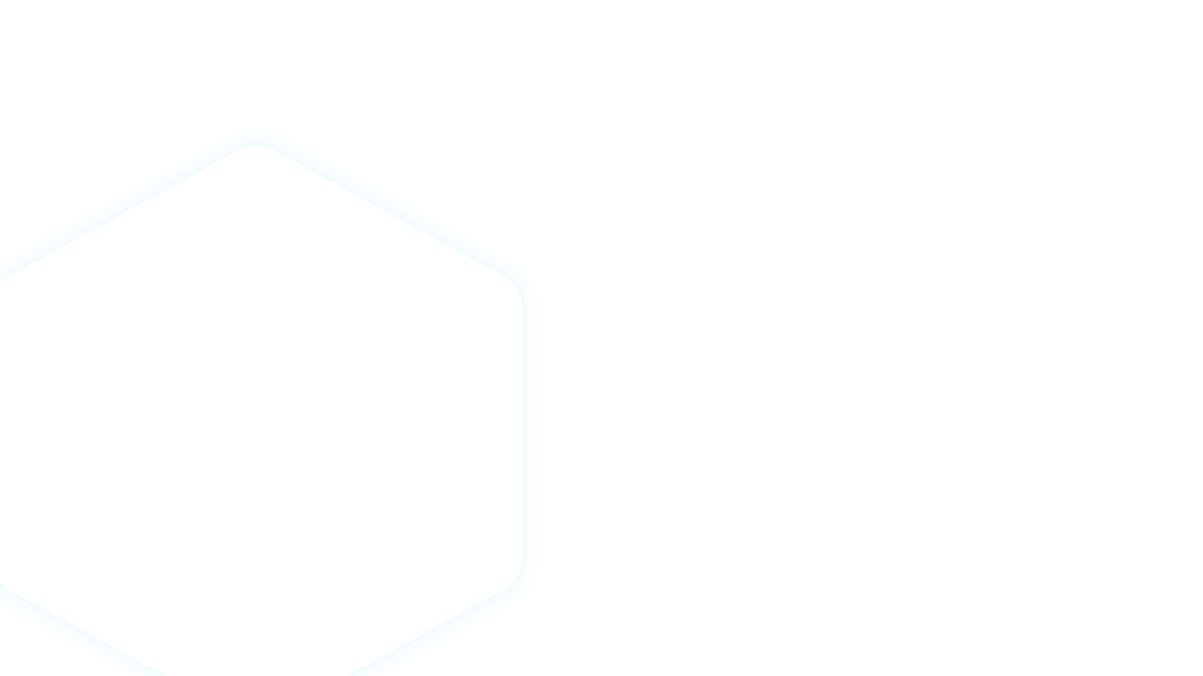
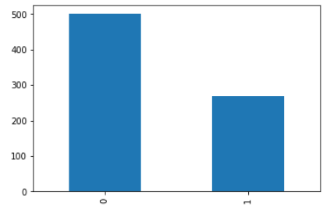

CONSIDER THE FOLLOWING PROBLEM
NO DIABETES
DIABETES

Slide 6
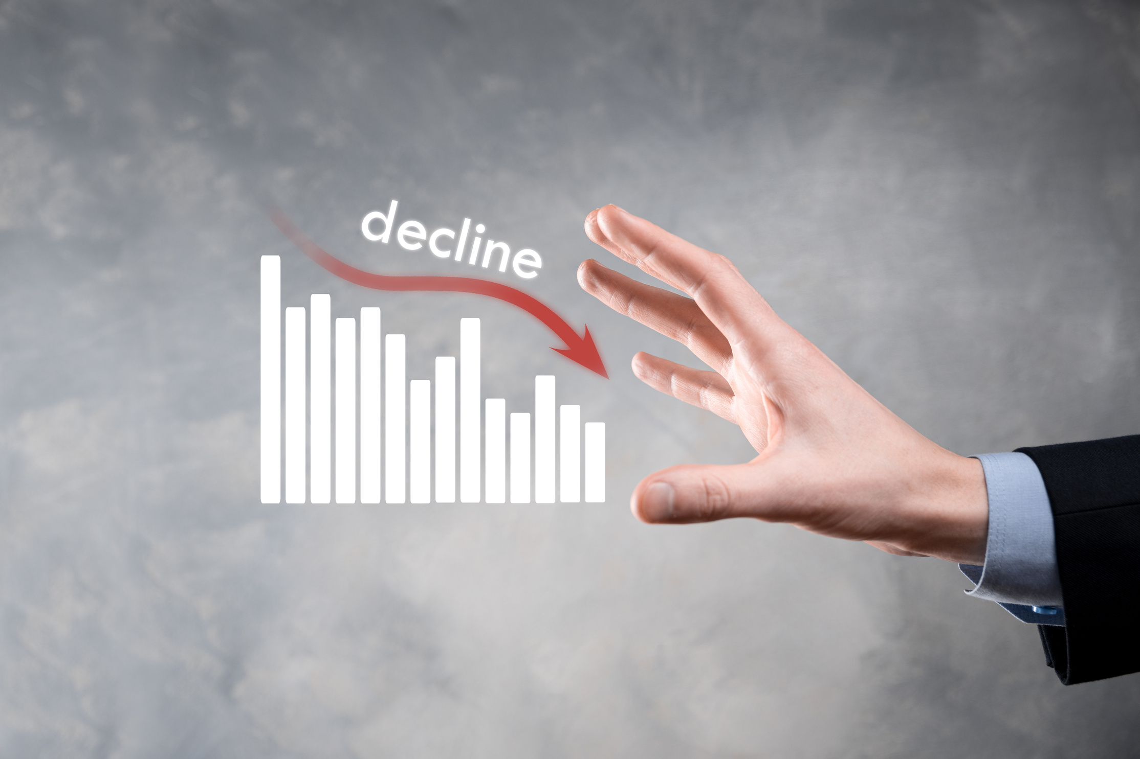

EVALUATION METRICS
A Linear Regression yields an accuracy of 0.80
What about precision? Recall? F1?
To not be deceived always make sure you test using the correct metric

Slide 7



THE MODEL
Some models perform better than other when it comes to imbalanced data
Which algorithms do you think will perform poorly?

Slide 8
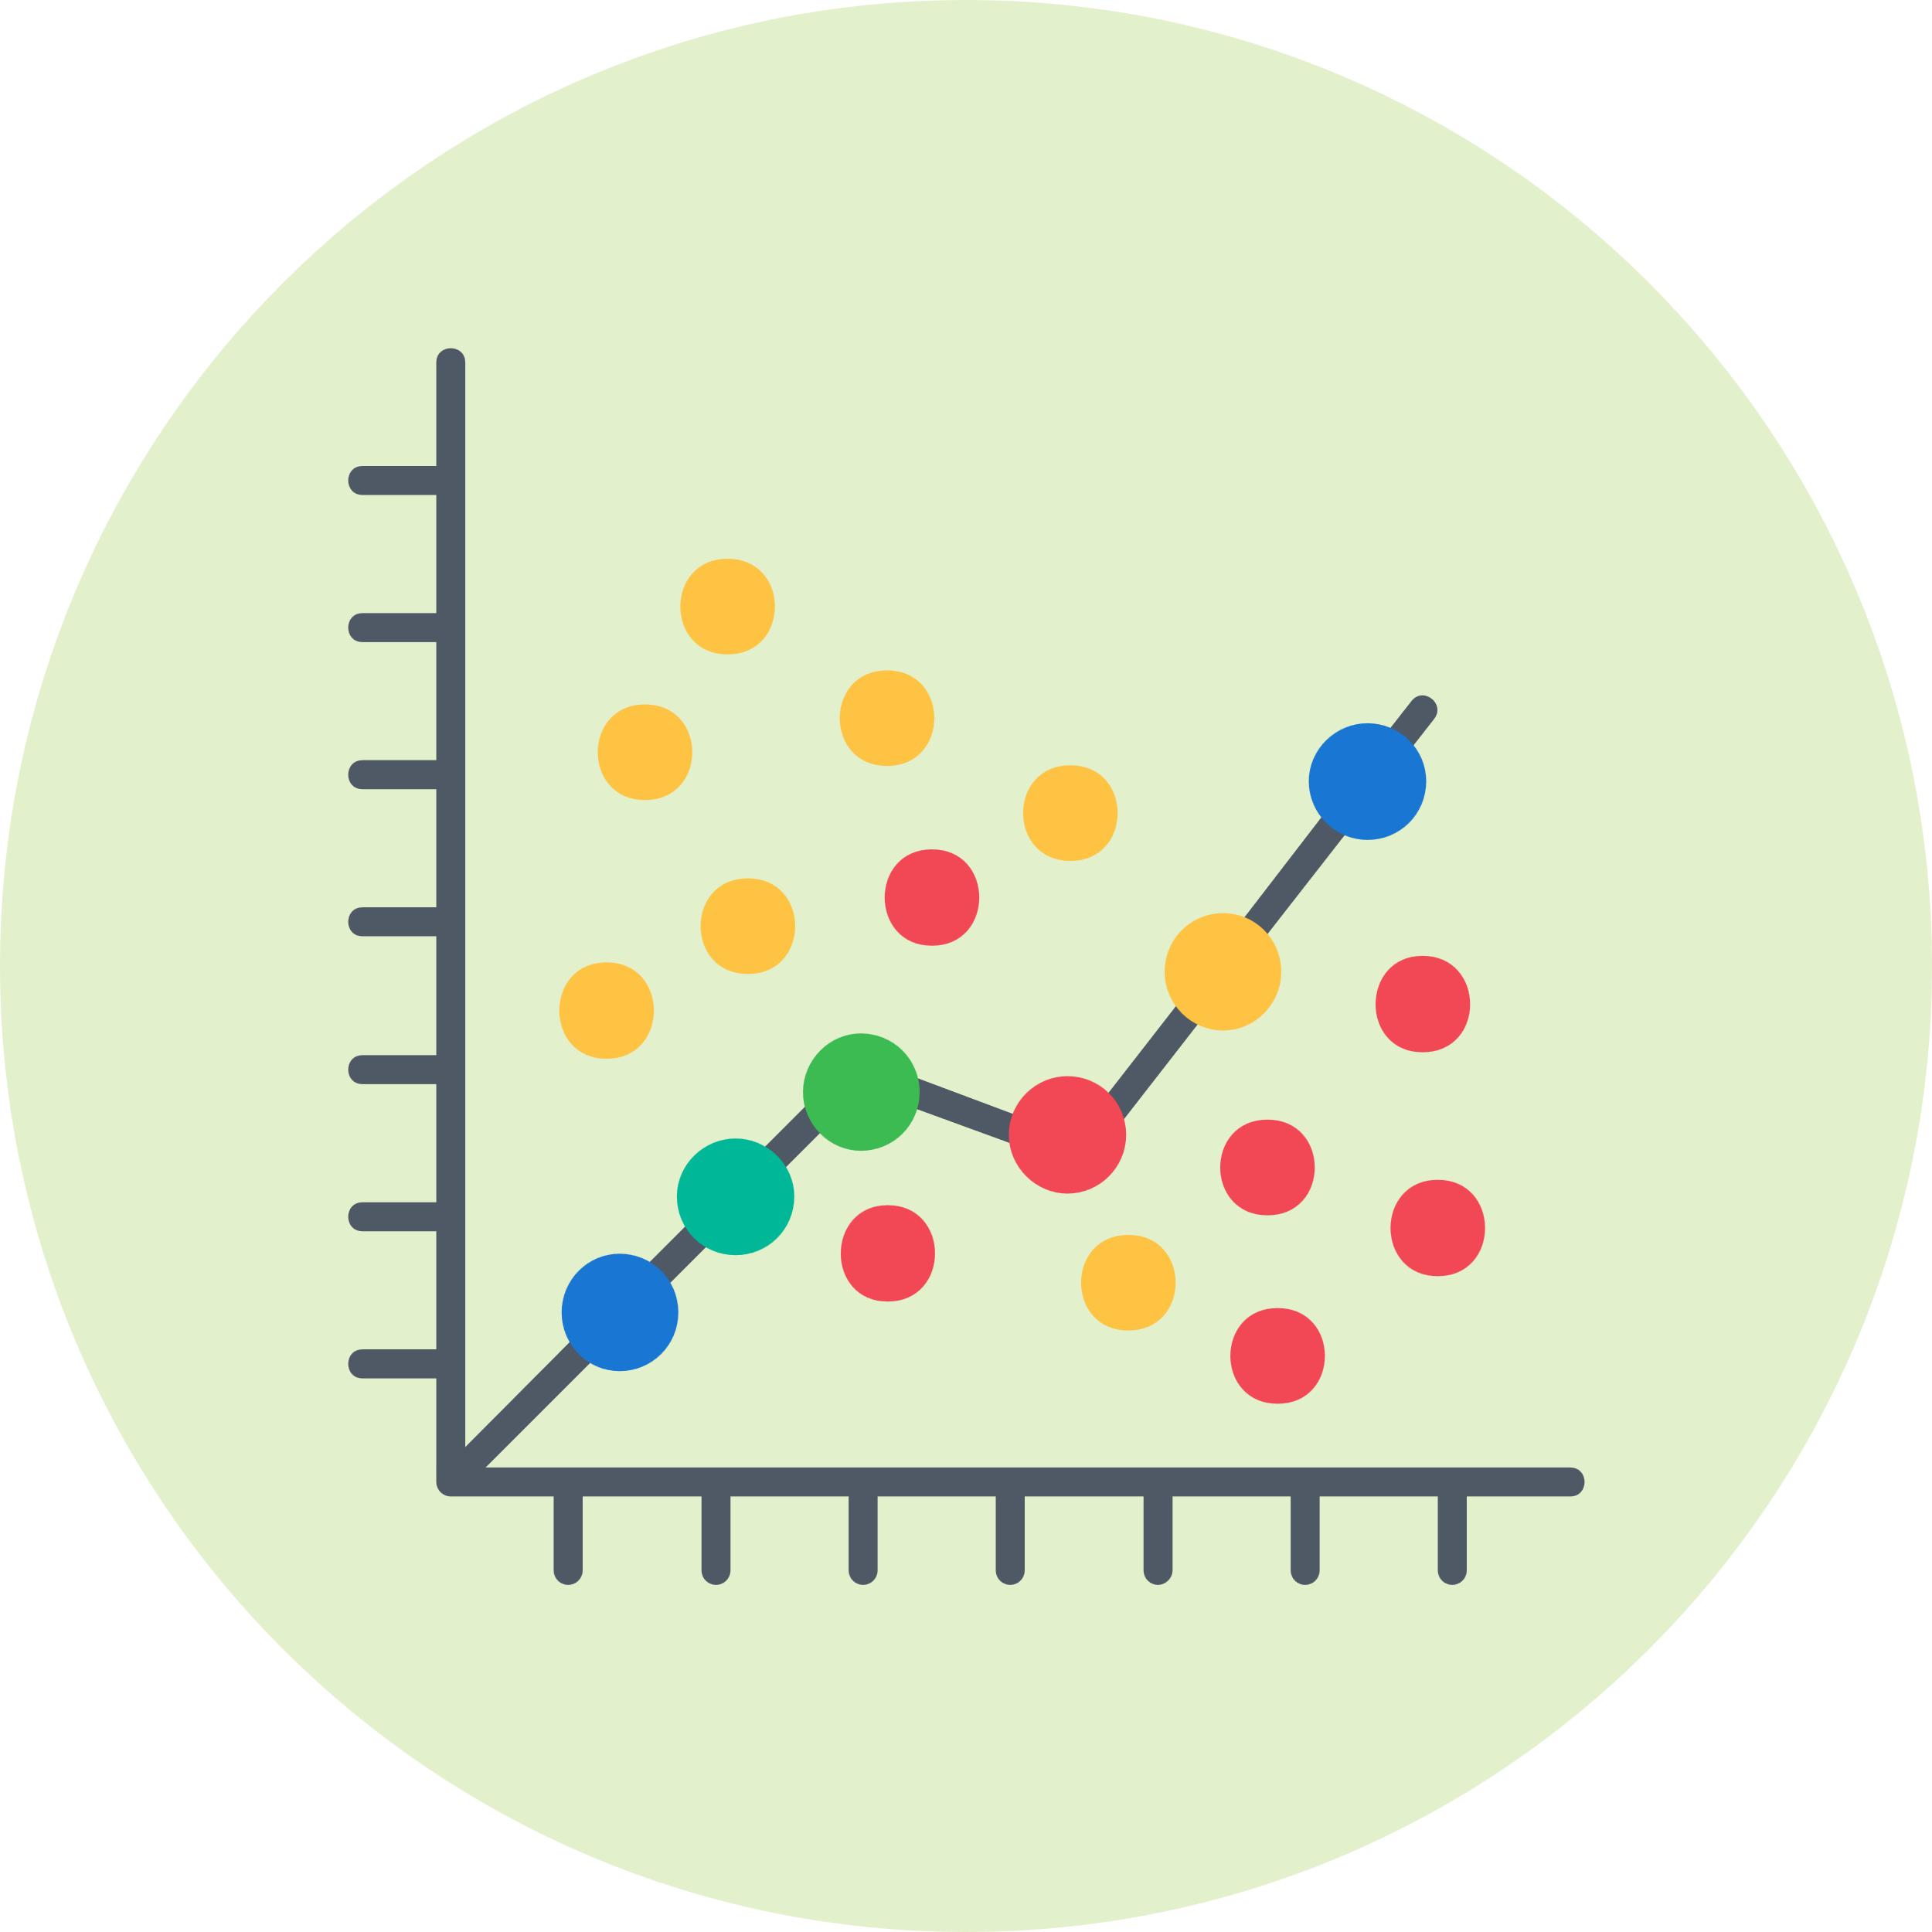

THE MODEL
Some models perform better than other when it comes to imbalanced data
Which algorithms do you think will perform poorly?
Poorly -> neighbour voting algorithms -> KNN, Logistic Regression

Slide 9

THE MODEL
Some models perform better than other when it comes to imbalanced data
Which algorithms do you think will perform poorly?
Poorly -> neighbour voting algorithms -> KNN, Logistic Regression
Tree based models are more greedy and therefore significantly improve the ability to deal with imbalanced classes
So we should try a Random Forest method (We will learn it very soon!)

Slide 10
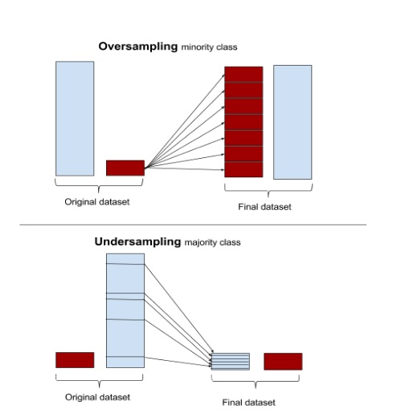
RE-SAMPLING - OVERSAMPLING MINORITY CLASS
Counting the minority class instances several times in order to create an artificial balance
You should ALWAYS perform the oversampling technique after the train test split, or else you may incur serious overfitting

Slide 11
RE-SAMPLING - OVERSAMPLING MINORITY CLASS
After doing this on our previous example we improved recall a lot

Slide 12
RE-SAMPLING - UNDERSAMPLING MAJORITY CLASS
On the other hand, you can perform undersampling of the majority class by simply removing instanced of the majority thus creating again an artificial balance

Slide 13
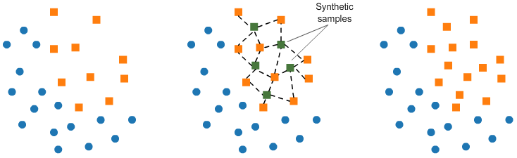
RE-SAMPLING - SYNTHETIC SAMPLE GENERATION
SMOTE - Sythetic minority oversampling technique
Performs oversampling but by generating nearest neighbours of the minority class without copying them

Slide 14
CLUSTERING THE ABUNDANT CLASS
Similar to undersampling but instead of taking a random subset, you create clusters of the majority class and use the cluster centers as the "samples" do be inserted in the final dataset

Slide 15
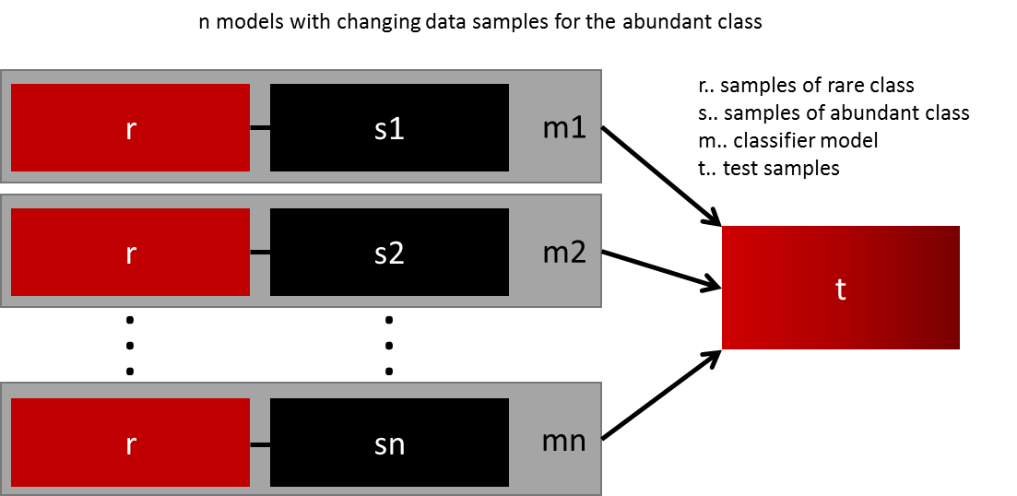
ENSEMBLE METHODS - BAGGING AND PASTING
creating an ensemble of undersampled classifiers
or
k-fold, but always make sure the minority class is all included

Slide 16
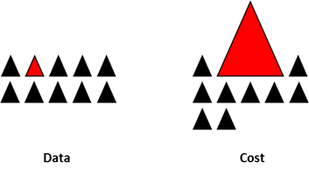
MODEL MODIFICATION - COST FUNCTION
The cost function attributes a penalty to an incorrect submission
If we modify the cost function to attribute a much larger penalty to an incorrect prediction of the minority class this will "force" the algorithm to take more attention for those cases

Slide 17




ANY QUESTIONS ?

